Slide 1

MICROGRIDS

Slide 2


Meet our team
SIDDHARTH TAPRE
11018545
ROHAN KULKARNI
11027694

Slide 3
INDEX
INTRODUCTION
DATA
OBJECTIVES
METHODOLOGY
RESULTS
CONCLUSION

Slide 4
INTRODUCTION
02
4

Slide 5

INTRODUCTION
In today's quest for sustainable energy solutions, microgrids with photovoltaic (PV) panels have emerged as game-changers. We're here to explore predictive modeling techniques that enhance PV generation within microgrids. Our goal is to bridge the gap between environmental factors and PV output, ushering in a more efficient, reliable, and sustainable energy future.

Slide 6
DATA
02
6

Slide 7
DATA
Our research leverages two datasets to enrich our analysis. The primary dataset originates from a Berlin-based microgrid, encompassing the entire year of 2022 with hourly timestamps. This dataset forms the backbone of our study, capturing a wide range of variables crucial for PV output analysis.
In addition to the primary dataset, we also incorporate the Liege dataset, sourced from a scientific paper. This secondary dataset plays a pivotal role in our initial analysis and learning, providing valuable insights and context for our research.
The dataset has 270 columns and 8760 rows.

Slide 8
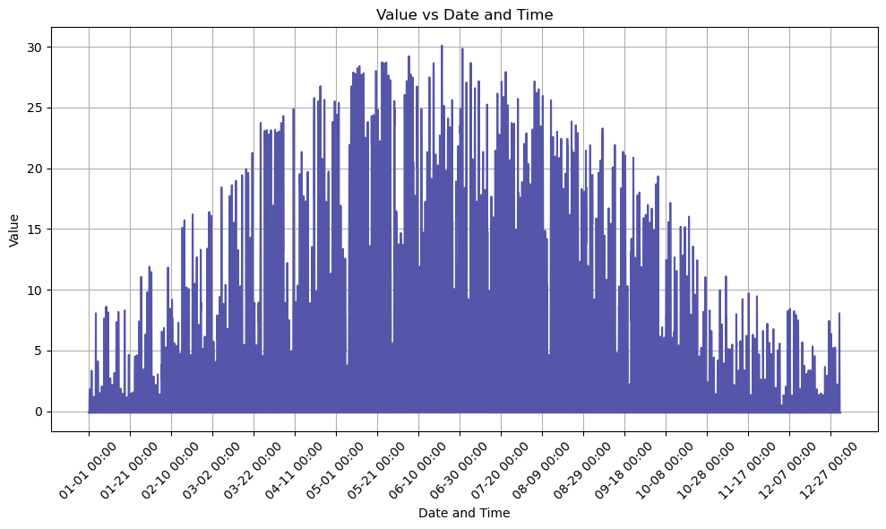
DATA UNDERSTANDING
The dataset has 270 columns out of which the weather data columns selected are 23.
Power generated over the year

Slide 9
OBJECTIVES
03
9

Slide 10
OBJECTIVES
Our study is driven by two fundamental goals. Firstly, we seek to measure how environmental factors influence PV system efficiency. Secondly, we scrutinize machine learning models to forecast PV output using these factors as inputs. The outcome is an enhanced microgrid PV prediction by studying the environmental factors.

Slide 11
METHODOLOGY
04
11

Slide 12
METHODOLOGY
Leveraging the renowned Liege dataset to analyze the impact of weather variables on PV system performance, emphasizing their primary role in driving PV energy generation within the dataset.
Combined the Liege dataset learnings with a main microgrid dataset, covering 2022 data and featuring 18 carefully chosen variables spanning environmental and operational metrics, enriching the research.

Slide 13
METHODOLOGY
In our rigorous methodology, we executed a multi-stage process encompassing data preprocessing, exploratory data analysis, and the meticulous selection of diverse machine-learning models. These models underwent comprehensive parameter tuning and optimization to ensure their peak performance. Our evaluation was thorough, assessing six models—Linear Regression, Lasso Regression, Ridge Regression, Decision Tree, Random Forest, and Neural Network—utilizing essential metrics like Mean Squared Error (MSE), Mean Absolute Error (MAE), and R-squared values. Additionally, we visually presented plots for intuitive comparisons, enhancing our understanding of model performance

Slide 14
RESULTS
05
14

Slide 15
RESULTS
In today's quest for sustainable energy solutions, microgrids with photovoltaic (PV) panels have emerged as game-changers. We're here to explore predictive modeling techniques that enhance PV generation within microgrids. Our goal is to bridge the gap between environmental factors and PV output, ushering in a more efficient, reliable, and sustainable energy future.

Slide 16
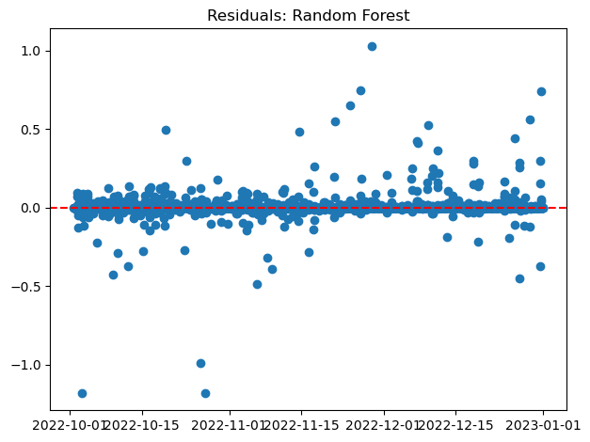
VISUALS
This is a visual representation of the residuals i.e. actual VS predicted PV generation
The red line(0.0) is where they completely match each other.
As we can see there is very little deviation from the actual data.

Slide 17
RESULTS TABLE
scores | Linear regression | lasso | ridge | Decision tree | Random forest | Neural network
MSE | 0.022 | 0.02 | 0.022 | 0.008 | 0.005 | 0.007
MAE | 0.088 | 0.082 | 0.088 | 0.025 | 0.173 | 0.047
RMSE | 0.149 | 0.144 | 0.149 | 0.093 | 0.073 | 0.084
R-squared | 0.997 | 0.997 | 0.997 | 0.998 | 0.999 | 0.999

Slide 18
CONCLUSION
06
18

Slide 19
CONCLUSION
We studied a range of machine-learning techniques to predict PV output within a microgrid. The Random Forest algorithm stands out for its ability to navigate intricate environmental variables, potentially revolutionizing microgrid management, improving energy efficiency, and advancing global climate objectives. Beyond its microgrid context, this research provides a practical roadmap for sustainability, bridging academic exploration with actionable solutions to address pressing energy and environmental challenges.

Slide 20
THANK YOU
SIDDHARTH TAPRE
11018545
ROHAN KULKARNI
11027694
20

